Slide 1
Scalable and Privacy-preserving Design of On/Off-chain Smart Contracts
Chao Li, Balaji Palanisamy, Runhua Xu
School of Computing and Information
University of Pittsburgh

Slide 2
Introduction
Background
On/off-chain smart contracts
Enforcing off-chain contracts
Implementation
Conclusion

Slide 3
Blockchains in Industry
1st generation - value transfer
2nd generation - smart contracts
By 12/2018, there have been 2068 different cryptocurrencies listed in CoinMarketCap.com with a total market cap over 121 billion USD.
Source: https://www.statista.com/statistics/647231/worldwide-blockchain-technology-market-size/

Slide 4
Blockchains in Academia
Functionality
Scalability
Privacy
blockchain
Security
Efficiency
Source: https://app.dimensions.ai/analytics/publication/viz/overview-publications?search_text=blockchain
Decentralization

Slide 5
Blockchains: the 1st generation
new
…
package
In the network, users can issue transactions to transfer cryptocurrency
Blockchain users form a P2P network enabling broadcast of messages
Through consensus protocols, users are randomly selected to pack transactions as blocks and append new blocks to the blockchain.

Slide 6
Ethereum: the 2nd generation
Alice wants her 1 Ether to be transferred to Bob after a specific time.
$${Alice}^{′}s transaction$$
$${Alice}^{′}s contract$$
$$…$$
$\{$
from: Alice’s address
to: N/A
data: bytecode of new contract
value: 1 ether
$$\}$$
$$…$$
$function withdraw \left( \right) public \{$
require(msg.sender == Bob’s address);
require(now > a specific time);
msg.sender.transfer(1 ether);
$$\}$$
$$…$$
$$…$$
$${Bob}^{′}s transaction$$
$\{$
from: Bob’s address
to: address of Alice’s contract
data: bytecode of function call
value: 0
$$\}$$
$$…$$
$${Bob}^{′}s function call$$
$$byte4(hash(withdraw()))$$
$$…$$

Slide 7
Ethereum: scalability
5,000,000
2,199,000
2,461,000
block
1,871,000
1,134,000
2,461,000
1,230,000
1,134,000
2,199,000
1,230,000
1,871,000
Transaction pool

Slide 8
Ethereum: scalability
contract example {
function A {}
function B {}
function C {}
function D {}
function E {}
}
contract example {
function A {}
function C {}
}
50,000
x3
800,000
x5
12,290,000
30,000
x8
1,100,000
x4
700,000
x5
390,000
reduce by 97%
function B {}
function D {}
function E {}

Slide 9
Ethereum: privacy
contract example {
}
function A {}
private
function B {}
private
function C {}
public
function D {}
private
function E {}
public
function A {}
function B {}
function D {}

Slide 10
Our solution: On/off-chain smart contracts
We broadly classify functions of smart contracts into two categories based on the computing resources spent for executing them and the sensitive information carried by them:
heavy/private functions involving high-cost calculation or sensitive information;
light/public functions involving none of these features.

Slide 11
Our solution: On/off-chain smart contracts
all-on-chain
a smart contract
hybrid-on/off-chain
f1: light/public
f2: heavy/private
participants
f3: light/public
miners
f4: heavy/private
miners
f5: light/public
f6: heavy/private
state change example
S1
S2
S3
S4
S5
f2
f3
f4
f5
all-on
miners
miners
miners
miners
hybrid-on/off
participants
participants

Slide 12
Enforcing off-chain contracts
Split & generate
Deploy & sign
Submit & challenge
Dispute & resolve
Split & generate
on-chain contract
original contract
light
public
Before any on-chain activity, the original contract is first split to two parts that package light/public functions and heavy/private functions, respectively.
We need to pad each group of functions with a few extra functions prepared for a dispute.
After padding, we have already generated an on-chain contract as well as another off-chain contract from the whole contract.
light
public
extra
heavy
private
heavy
private
extra
off-chain contract

Slide 13
Enforcing off-chain contracts
Deploy & sign
on-chain contract
The on-chain contract can then be deployed by any participant to the blockchain.
The off-chain contract needs to be converted into bytecode to be signed by all the participants.
Each participant must obtain a copy of the off-chain contract with signatures from all the participants before any interaction with the deployed on-chain contract can take place.
original contract
light
public
light
public
extra
heavy
private
heavy
private
bytecode
extra
signatures
off-chain contract
signed copy

Slide 14
Enforcing off-chain contracts
Submit & challenge
on-chain contract
There will be a challenge period after a representative of the participants have submitted the result.
During the challenge period, all other participants can challenge the result with the signed copy of the off-chain contract.
If the representative is honest, there will be no need to challenge the submitted result.
original contract
light
public
heavy
private
light
public
extra
heavy
private
heavy
private
bytecode
extra
signatures
off-chain contract
signed copy

Slide 15
Enforcing off-chain contracts
Dispute & resolve
on-chain contract
verified instance
To resolve a dispute, during the challenge period, any honest participant can submit the signed copy to the on-chain contract.
An extra function padded to the on-chain contract during the split/generate stage will be called to verify the signed copy through signatures and create a verified on-chain instance.
original contract
light
public
heavy
private
light
public
create
extra
extra
heavy
private
dispute
heavy
private
bytecode
extra
signatures
off-chain contract
signed copy

Slide 16
Enforcing off-chain contracts
Dispute & resolve
on-chain contract
verified instance
A participant can then invoke the heavy/private functions within the verified instance to make them be executed by the miners.
Then, an extra function padded to the off-chain contract will be invoked to send the true result back to the on-chain contract.
Another extra function padded to the on-chain contract will receive the true result, enforce the dispute resolution and penalize the dishonest participant.
original contract
light
public
heavy
private
light
public
create
extra
extra
enforce
heavy
private
dispute
heavy
private
bytecode
extra
signatures
off-chain contract
signed copy

Slide 17
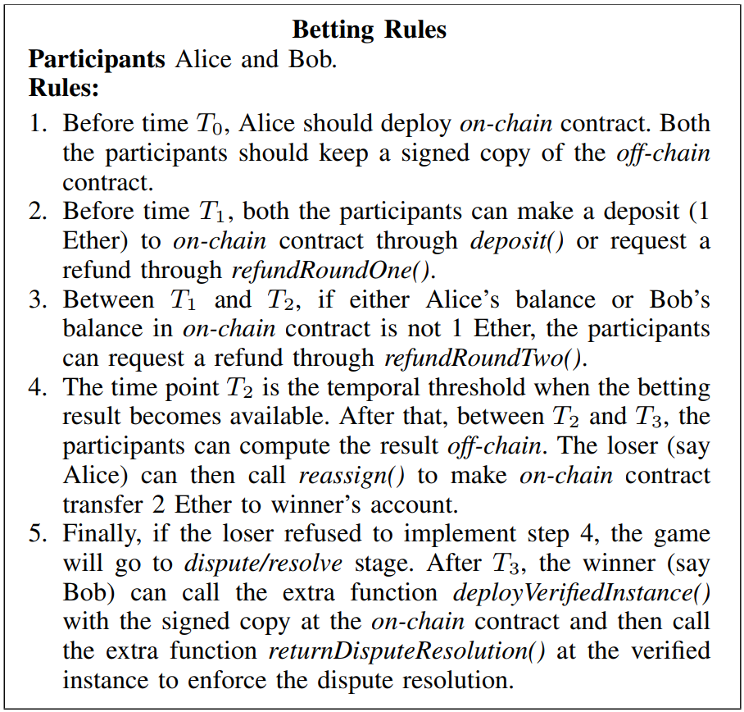
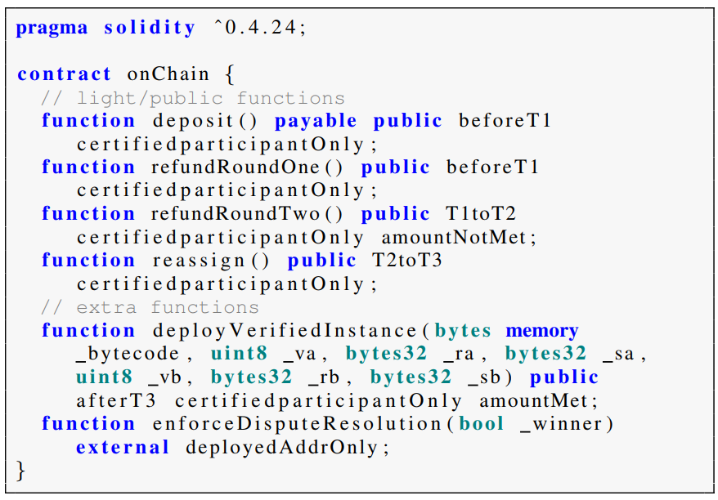
Implementation

Slide 18
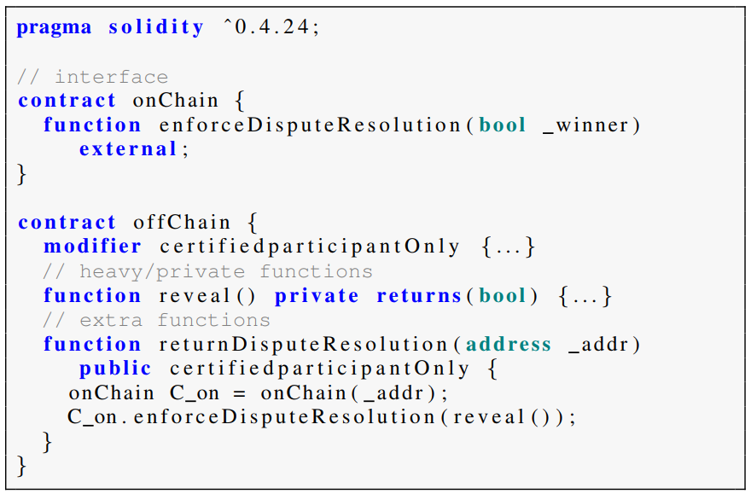
Implementation

Slide 19
Conclusion
In this paper, we propose a general hybrid-on/off-chain execution model of smart contracts, which separates the heavy/private functions of a smart contract from the light/public ones to form an off-chain contract and enables the off-chain contract to be executed only by the interested participants.
To handle disputes caused by any dishonest participants, we propose a mechanism that allows any honest participant to reveal a signed copy of the off-chain contract so that a verified instance can be created to make miners enforce the true execution result.
Our implementation and evaluation of the proposed approach using an example smart contract demonstrate the effectiveness of the proposed approach of using on/off-chain contracts in Ethereum.

Slide 20
Thanks, Q&A

